Slide 1
FUN STATS
Team Members:
Bharath Attaluri
GuruTeja Mannava
Pradyumna Doddala
Venkatesh Prasad Kalluri

Slide 2
Use Case:
John has a file that contains lots of numbers (all integer). They are unordered. He wants to generate some statistics around these numbers,
namely COUNT, MEAN, Standard Deviation, MIN, MAX, and 25th, 50th, and 75th percentiles. The numbers are so large that it cannot be
run on a single machine. Write a map-reduce program to generate above-mentioned statistics (no APACHE PIG, no HIVE).
Resources Used:
IBM Big Insights.
Eclipse(Java).

Slide 3
Map Reduce :
•MapReduce is a programming model and implementation for processing and generating large data sets
•In MapReduce a task is broken down into processing key-value pairs
•Users will specify a map function and a reduce function.
•Easy for a programmer to specify parallelism for data intensive tasks
•Open source implementation of MapReduce is available
–Hadoop (Java based), Phoenix (shared-memory, C based), Disco (Erlang/Python), and some more

Slide 4
Map Function:
•Creates a set of key-value pairs from the input data
•The input data is partitioned and the Map function is run over each partition
•Prototype
–map (k1,v1) à list(k2,v2)

Slide 5
Reduce Function:
•The set of intermediate key-value pairs generated by Map functions are merged
–All values that share the same key are collected,Requires sorting.
•The Reduce function accepts an intermediate key and a list of values associated with it
–A user defines how the list of values should be processed
–This Reducer will generate the Output.
•Prototype
–Reduce (k2, list(v2)) à list(v3)

Slide 6
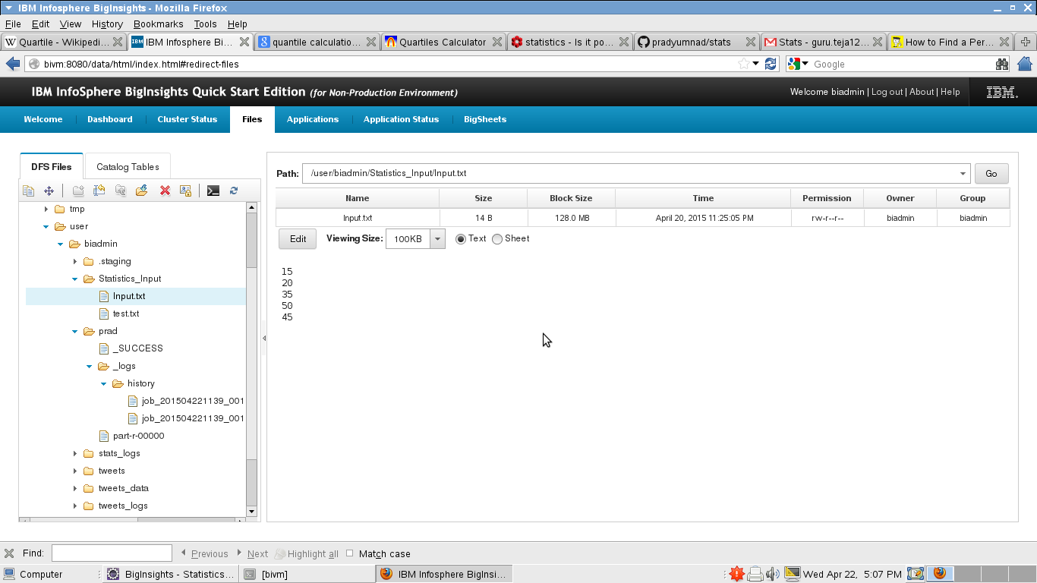
Implementation:
We can pass any number of input files,this is one input file .

Slide 7
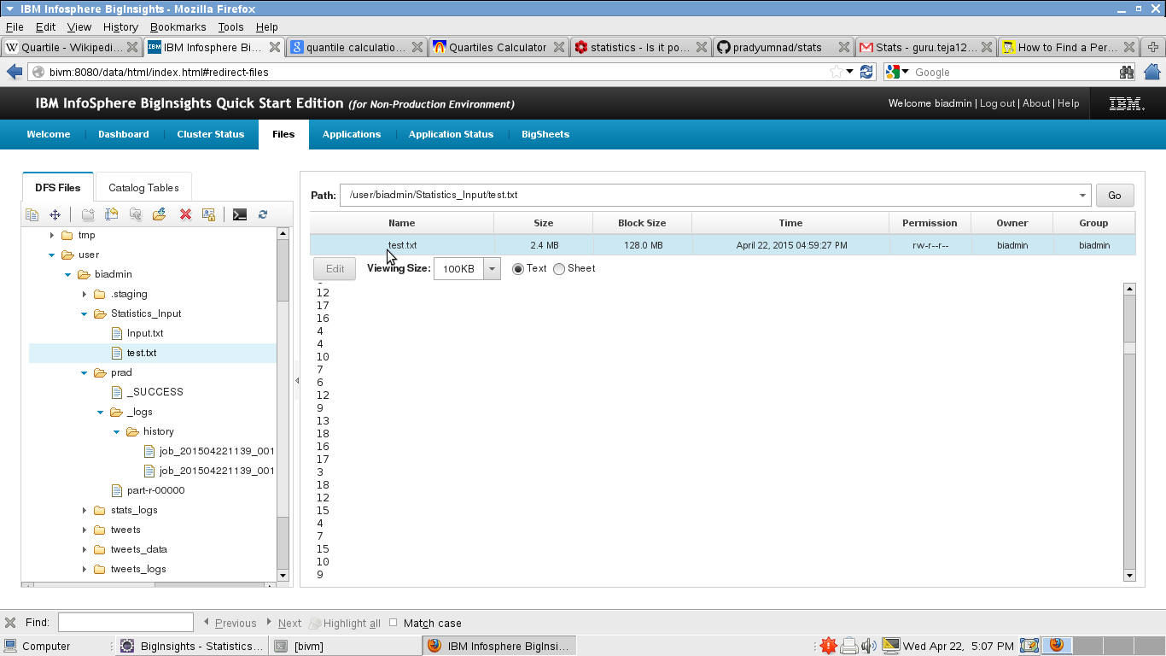
Test.txt is a auto generated file with 10 million random numbers (By using Datagenerator Class)

Slide 8
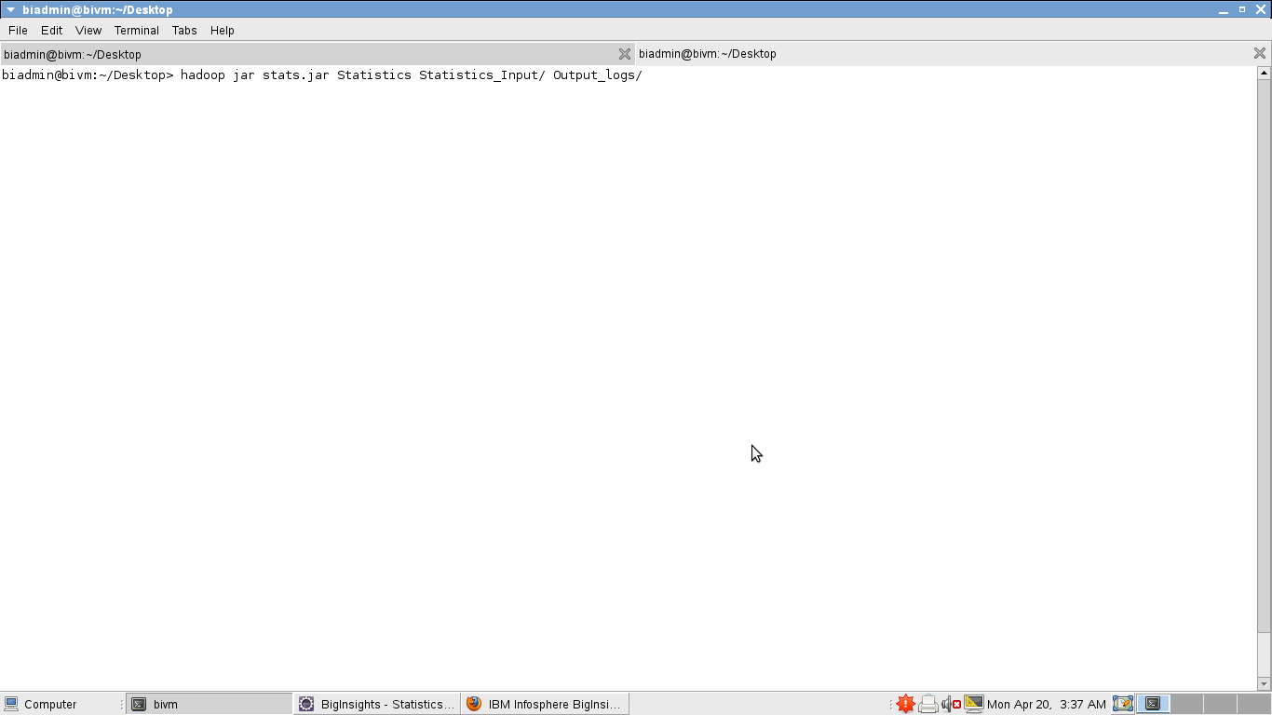
2. Execute the Jar file in hadoop by following command
>hadoop jar stats.jar Statistics Statistics_Input/ Output_logs/

Slide 9
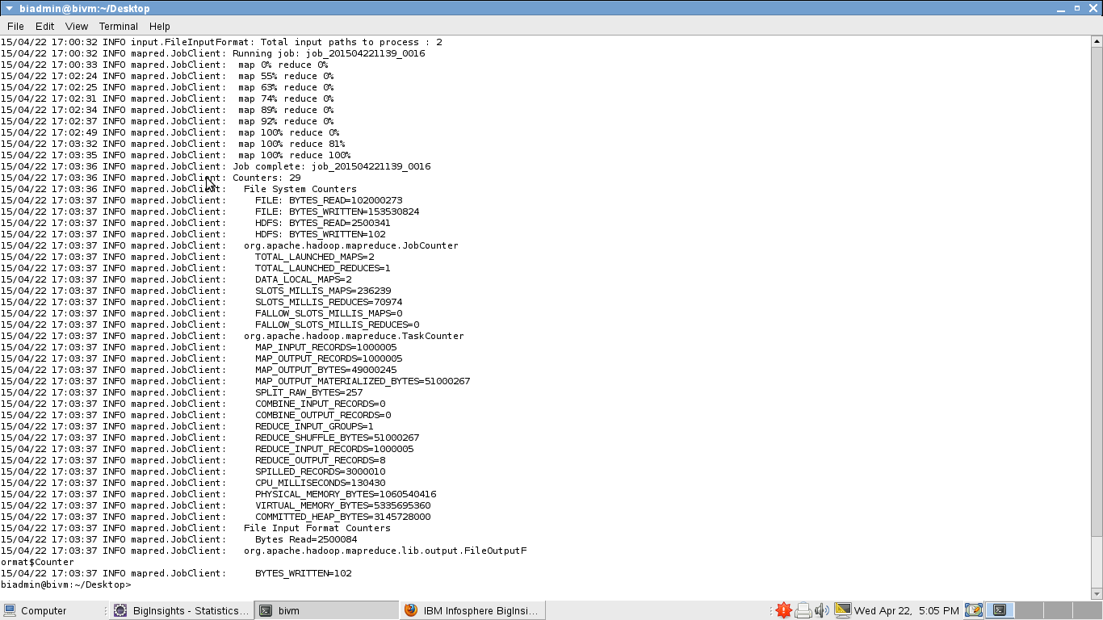
3. Map Reduce execution took around 3 minutes for computing 10 million numbers.

Slide 10
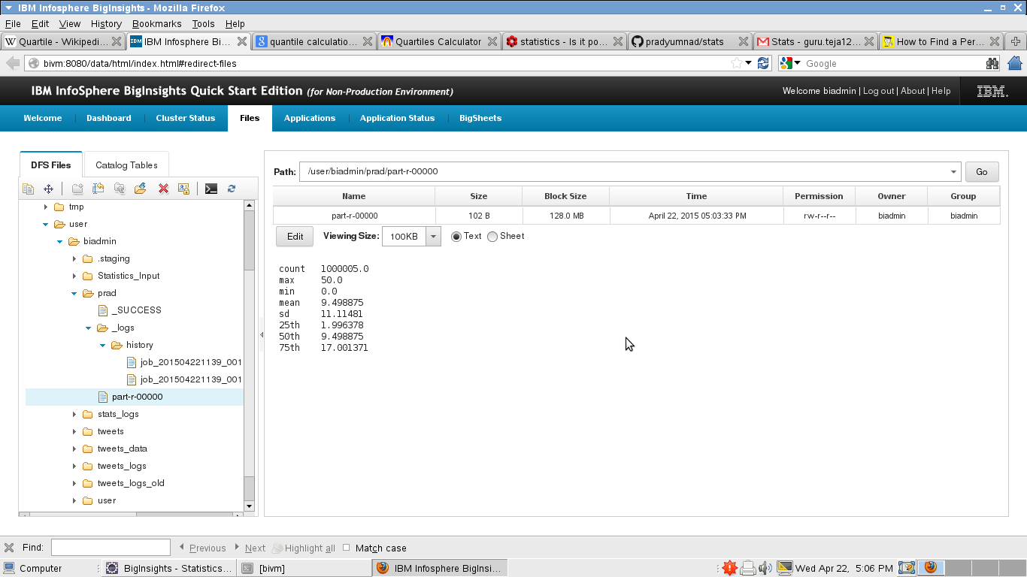
4. Final output with count,max,min,Standard Deviation,25th,50th and 70th percentile can be seen in the Hadoop file browser.

